Slide 1
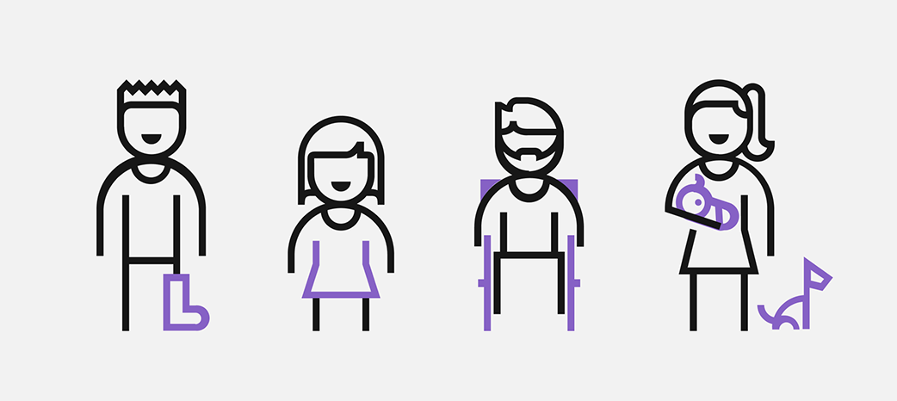
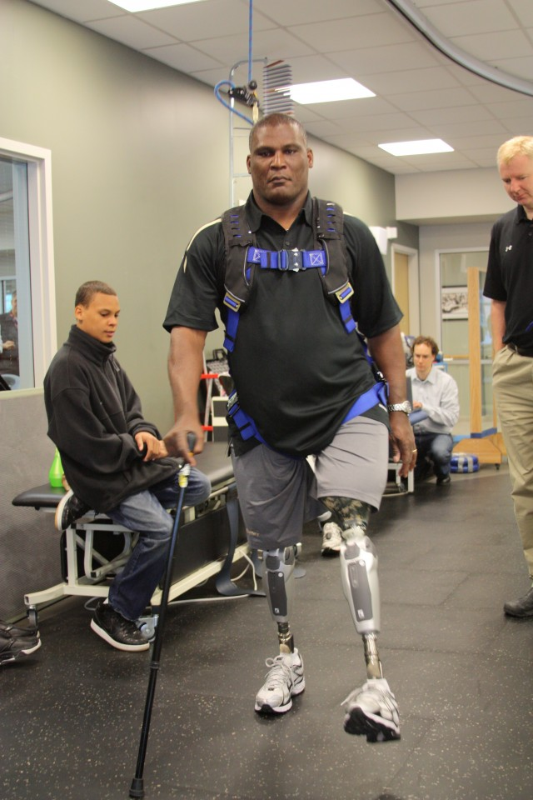
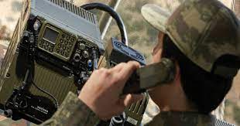
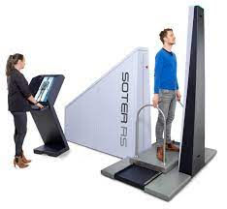
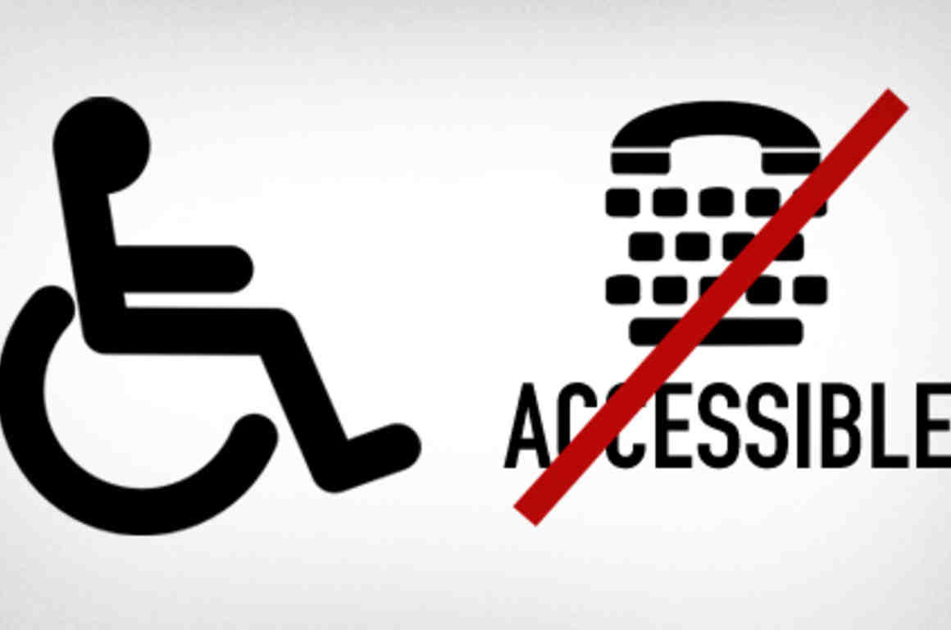
Prisoner’s Disabilities and Handicaps I’m talking about the how the prisoners will take advantage of technology and what are the things that affect them so bad to the handicaps and disability people. 1. Prisoner’s Don’t have access for phones because they did some crime and move to jail for long period where they can leave that place till complete the period of punishment, but they have lawyers which can connect them with there family by cell phones in jail with limited time only. 2. Internet use in prisons allows inmates to communicate with the outside world. However much like the use of mobile phones in prison, internet access without supervision, via a smartphone, or personal computer is banned for all inmates. 3. Innovations like thermal cameras, sensors and radio frequency identification (RFID) technology are also transforming the lives of people working in or incarcerated within the criminal justice system. 4. This is essentially the situation for prisoners who are deaf, hard of hearing, or who have speech disabilities. They cannot use the standard pay phones in prison, and the only means of accessible telecommunication to the outside world is through a Text Telephone (TTY) machine. This machine has a modified keyboard, specific rules on how to use it, and it transmits each letter and word slowly. 5. Scanning and detection devices can help spot everything, from a cell phone to a knife. Devices using radio waves can track prisoner and staff movements within an institution. New computer programs may help predict where problems are most likely to occur. 6. So many prisoners don’t know how to read write or use technology in jail so the tech training in prisons could help the incarcerated adjust to society once they are released. https://www.aclu.org/blog/smart-justice/mass-incarceration/prisons-outdated-technology-prevents-those-disabilities
Mangesh Raut INFO 608-900 Winter 2022-23
Week 05-06 - Design For The Real World: designing for non-obvious disabilities
Soldier’s Disability and Handicaps
Wounded warrior handicap soldier using first time next generation Artificial power legs.
1.The cost of using internet services on army bases are high because their location may be far and some that area where people are not living or no mans land type area so connecting to people o is hard which is their disability that can overcome due to satellite phones which help them to reach the other people with same frequency.
2.Some soldiers injured while war they loss their body parts in that situation and they are handicaps which is bad disability for living in real world which can overcome to follow technology helps which lives their life better.
3. Gadson is the first person to use the completed version of the Power Knee2, a next-generation powered prosthetic knee featuring new artificial intelligence and sensor technology that makes it possible for above-the-knee amputees to walk with increased confidence, safety and a more natural gait.
4. the customized wheelchairs help veterans keep up with their kids, handle yard work and enjoy hobbies. For Vazquez, the wheelchair will help her manage her new property in Tennessee, which has several acres and a very long driveway.
5. By being voice activated, users with physical disabilities can find themselves some ease. These devices can control lights, televisions, and more. According to Helping Hands, they will never be able to replace the human touch of care, but they can be a very valuable home assistant.
6. Electrical simulation, Helmet for blind, Next-generation Hearing aid, Bionic exoskeleton and Giving voice to the speech-impaired. All these things will help.
https://www.army.mil/article/20147/wounded_warrior_first_to_use_next_generation_powered_legs

